Slide 1
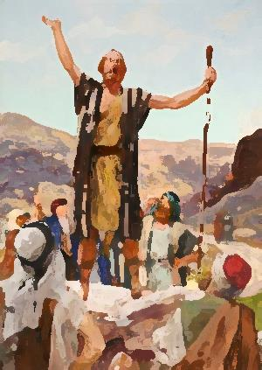
“Get
Ready!”

Slide 2
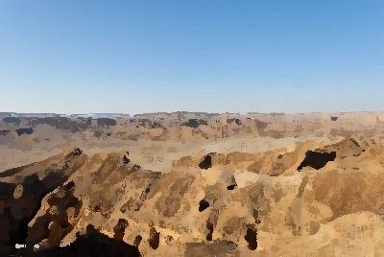
A voice cried out in the wilderness, “Prepare a way for the Lord.
The days are dark and the winds do howl. You need help to find the way.”
Thus God he spoke long years ago through John of humble birth.
But today He’s speaking to us still in words to rock the Earth.

Slide 3
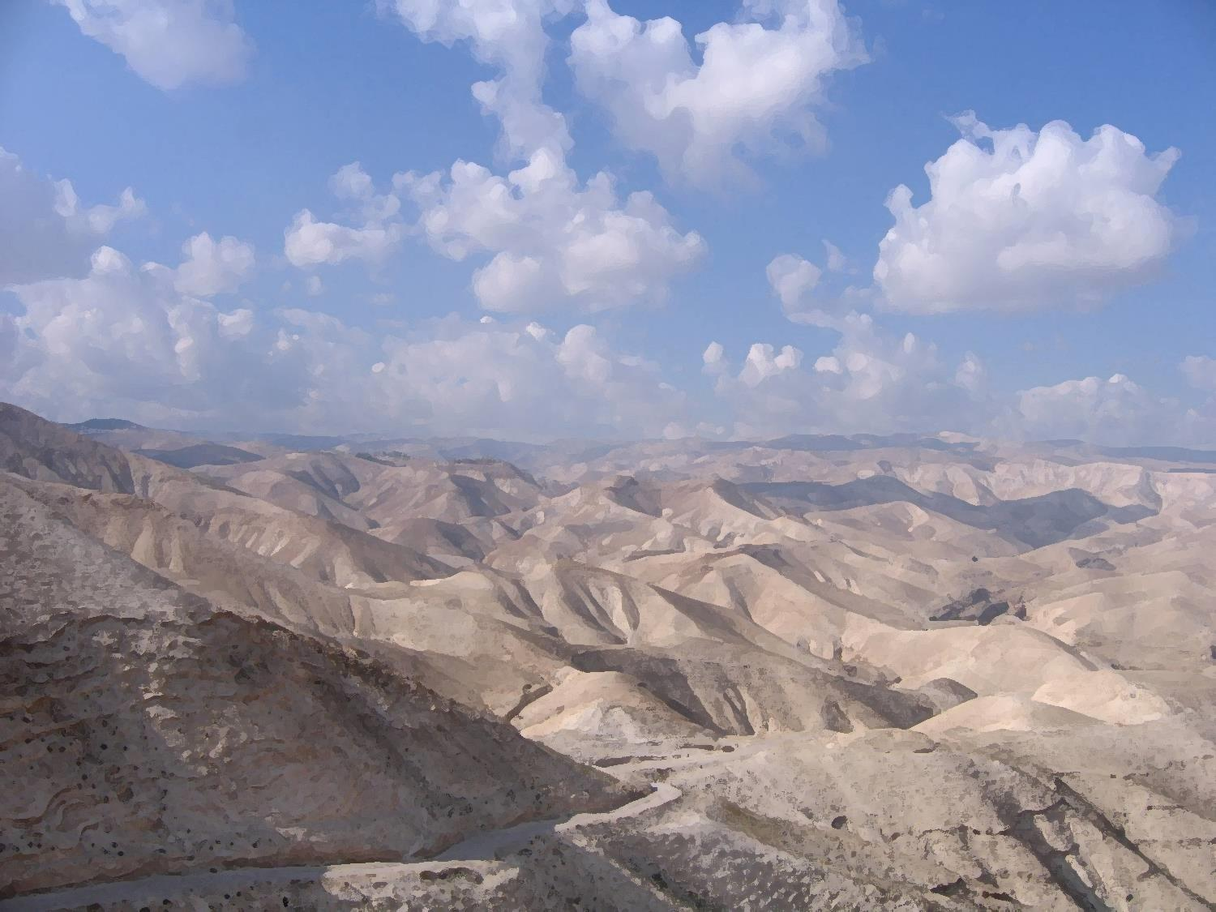
Get ready, you people, open up your minds,
Open up your hearts and leave the past behind.
Come to me and I’ll be with you
And we’ll walk hand in hand.
Get ready, you people, He’s come to Earth,
He’s defeated sin and he’s brought new birth.
He wants us all to follow Him
And leave the past behind.

Slide 4
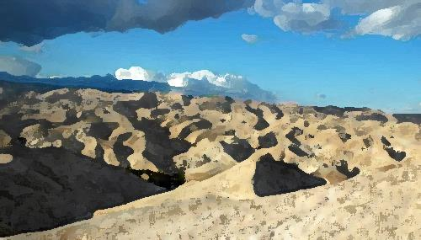
A voice cried out in the wilderness, “Prepare a way for the Lord.
The days are dark and the winds do howl. You need help to find the way.”
Thus God he spoke long years ago through John of humble birth.
But today He’s speaking to us still in words to rock the Earth.

Slide 5
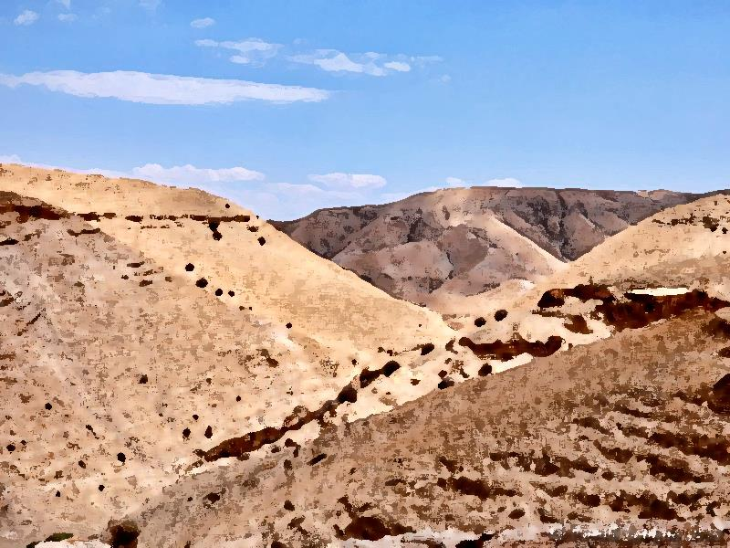
Get ready, you people, there’s a better way
With Jesus by your side through night and day.
Stay with Him and believe in Him
And your life will turn around.
Get ready, you people, He’s come to Earth,
He’s defeated sin and he’s brought new birth.
He wants us all to follow Him
And leave the past behind.

Slide 6
Get ready, you people, open up your minds,
Open up your hearts and leave the past behind.
Come to me and I’ll be with you
And we’ll walk hand in hand.

Slide 7
A voice cried out in the wilderness, “Prepare a way for the Lord.
The days are dark and the winds do howl. You need help to find the way.”
Thus God he spoke long years ago through John of humble birth.
But today He’s speaking to us still in words to rock the Earth.

